Slide 1

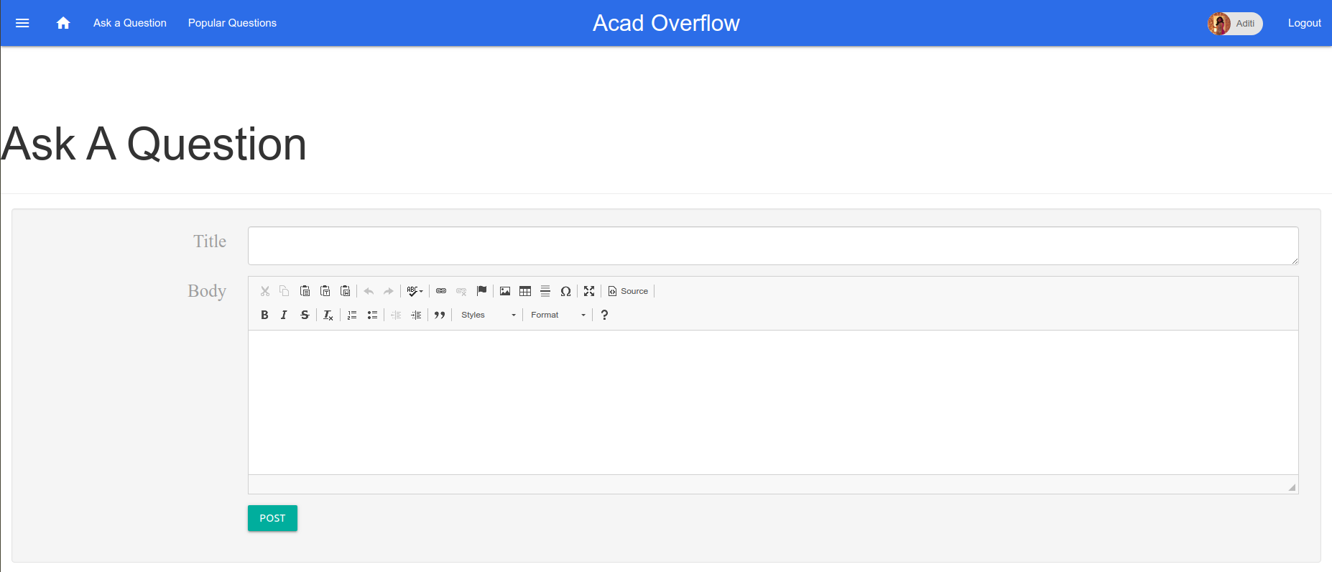
AcadOverFlow
Technical discussion platform for IIIT-H
Notes:
Main Slide(Presentation starts from here)

Slide 2
Team (#20) Members:
Name | Roll No.
Aditi Shrivastava | 2018201056
Bhavi Dhingra | 2018201058
Kajal Mohan Sanklecha | 2019801006
Surbhi Sharma | 2019202002
Nikita Rungta | 20161178
Samyak Agrawal | 20161180
Notes:
Please add your roll numbers here.

Slide 3
AcadOverFlow
In our IIIT campus, we mostly confine our technical discussions and knowledge sharing to a small group of friends.
AcadOverFlow is a platform for professional and enthusiast programmers of IIIT-H where technical questions can be posted/queried by any student, so that fellow peers can post responses to it or previously asked similar questions can be listed along with the answers.
Notes:
Main Slide(Presentation starts from here)

Slide 4
Innovation
We have built a Tag Prediction model for the queries.
Also included the vote counts and responses for scoring the questions.
Maintained sessions in the WebApp for showing user specific Dashboard.
Notes:
Main Slide(Presentation starts from here)

Slide 5
How did we go about design?
High Level Document: included various use cases, sequence diagrams and the architecture diagrams of the various modules.
Analysed the technologies required to implement the use cases.
The dataset for the required problem statement is quite big and we decided to run on ada servers.
For ML part we decided to go with python language for its simplicity and great ML libraries.

Slide 6
The coding principles
Single Responsibility Principle: Every module in our project has only a single responsibility by isolating the independent modules and abstracting their code when used in some other module.
Interface Segregation Principle: For each task, we have created individual file where, only that tasks related program is present.
Dependency Inversion Principle: High-level modules like WebServer backend, ML module, Database handling, etc. all provided abstractions.
Notes:
Please add your roll numbers here.

Slide 7
We managed our project using the following tools:
Microsoft Team: For group meetings.
Trello Board: Maintain a list of pending and completed tasks.
Github: used branches extensively.
Planned Scrum or Stand-up meetings on a regular basis.
Notes:
Please refer: https://yodiz.com/help/agile-scrum-meetings/

Slide 8
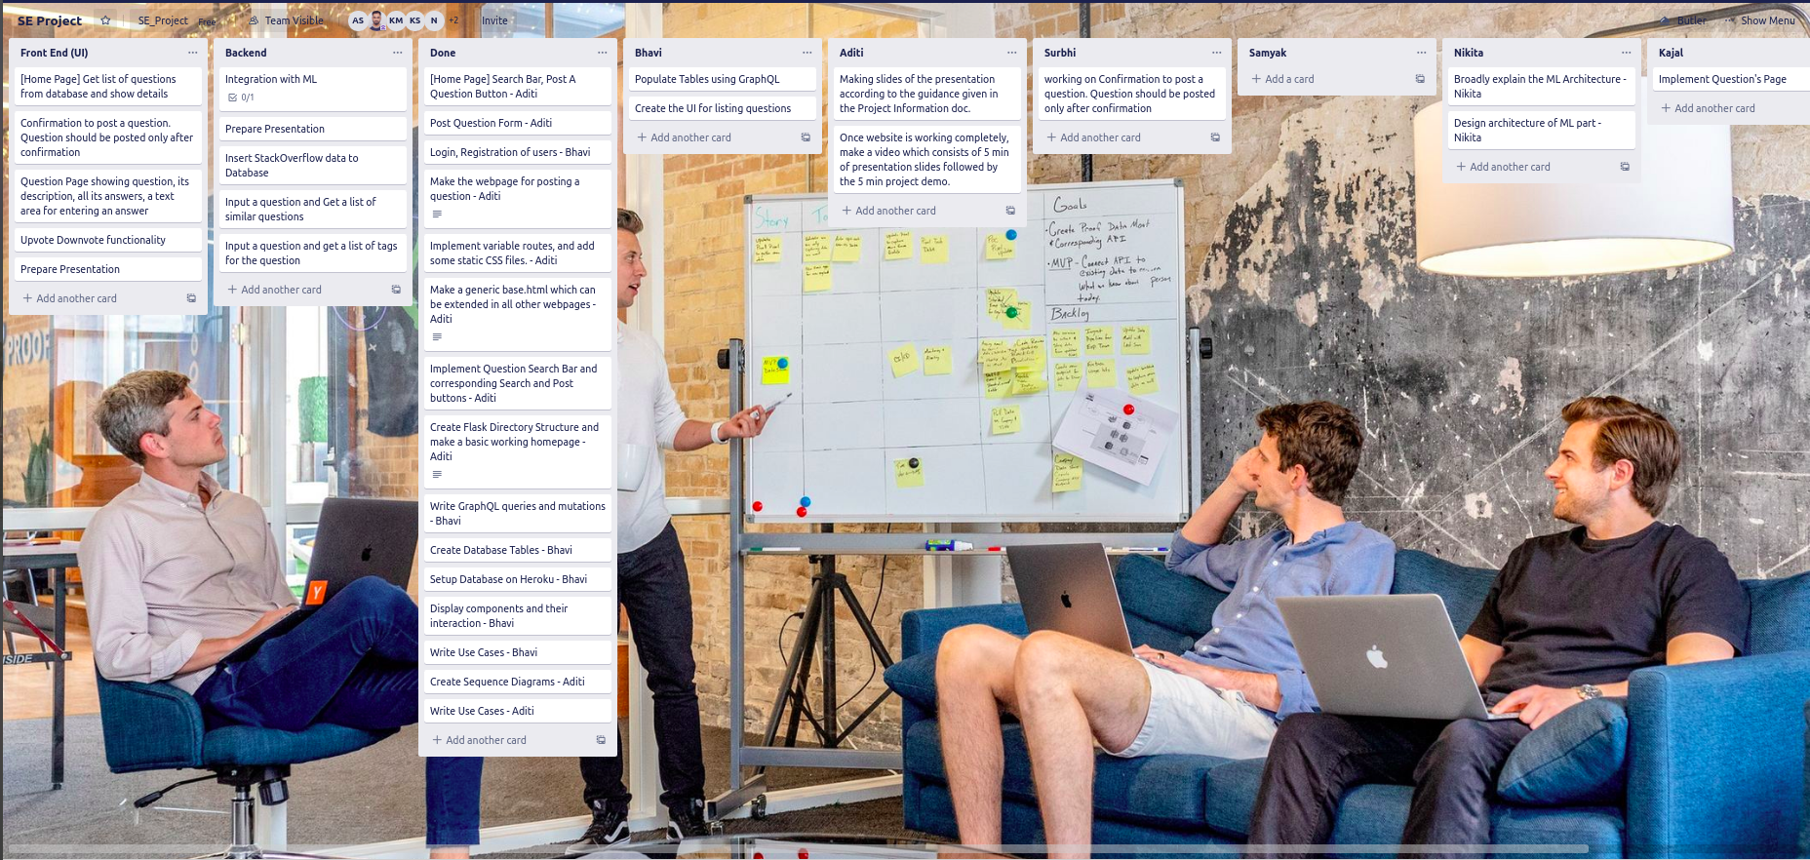

Planning
AcadOverFlow

Slide 9
Integration and Testing as remote teams
Two major independent modules a) WebApp and b) Tag Prediction & Semantic Search (NLP).
Exception Handling tested by entering spurious data as input to the system.
Code coverage tested by running all use cases.
For ML part we break the ML module in different independent modules. And we tested the functionality of each ML modules by generating random queries before moving on to the higher module. We also ensured the most readable and flexible outputs.
Integration was a crucial part. We analysed inputs/outputs of both modules properly and created function calls for more flexible input/output.
Horizontal Integration: As both of the modules are mostly independent the integration part became relatively easier.
Notes:
Please add your roll numbers here.

Slide 10
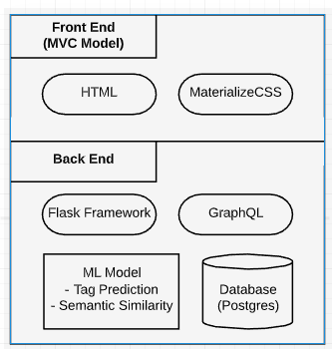
Web Application Architecture
AcadOverFlow

Slide 11
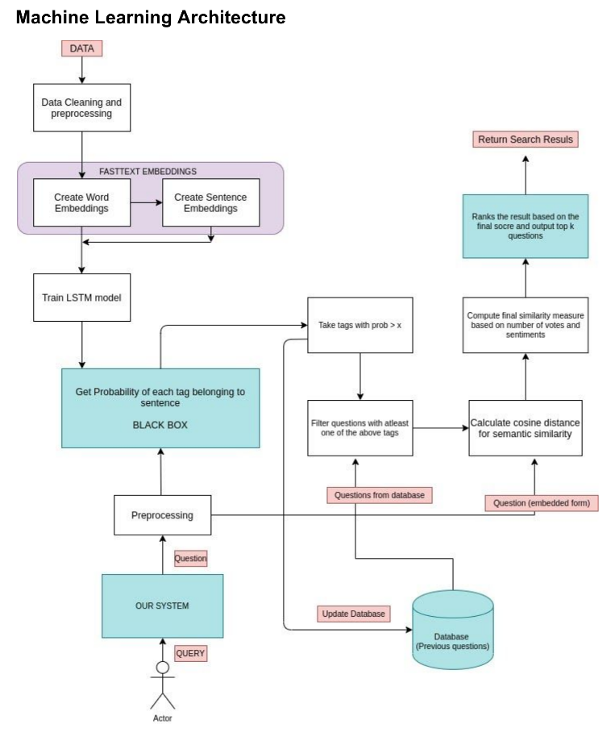
Tag Prediction & Semantic Search
AcadOverFlow

Slide 12
Learnings:
Work effectively as a team, and that also remotely, at this particular period of time of lockdown.
Productive and Effective team activities:
Scrum Meetings in every two days,
Creating minutes of meeting (MOM),
Using Trello for organising and tracking tasks
Using git branches.
As the project required a good knowledge of technical skills like NLP, Website designing (Flask-backend server), database management (GraphQL)), we learnt a lot as a team working on our specific modules.
We learnt various skills of Software Engineering to plan before implementation, i.e., how to get the big picture of the project using High Level Design Document, Sequence Diagrams, making use cases, Architectures Diagrams, etc.
Notes:
Please add your roll numbers here.

Slide 13
References
Creating a High Level Design Document
Improving Stack Overflow Using Semantic Search and NLP
Creating a GraphQL Server with Flask
How to Structure Large Flask Applications
Designing Web Applications Architectural Components

Slide 14
Questions?

